Slide 1
TPF Journey into the OpenSource Community
Barry Baker – Distinguished Engineer, z Systems Transformation Solutions

Slide 2



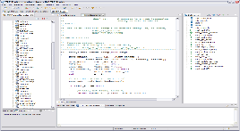

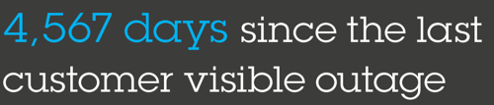

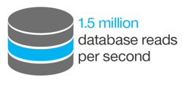
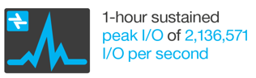
IBM z/Transaction Processing Facility
+
+
+
Near-real time OS kernel + Linux runtime for z Systems
High performance, non-relational database
Optimized, standards-based integration
Eclipse and Linux based development
z/TPF supports workloads that require…
Speed and high transaction throughput with 24x7 availability
Scalability to grow, incrementally and smoothly, with your business
Shared, always consistent, view of mission critical information required by your transactions
Notes:
z/TPF is optimized to support:
Fast, consistent access (less than one millisecond on current systems) to write intensive data in a large, single image database providing one consistent view of your critical data
Millions of moderate to complex transactions/second
Billions of end users
…all while providing superior reliability, availability and serviceability (RAS)
If you have ever booked an airline or train ticket, stayed in a hotel, or swiped your credit card, odds are you have used TPF

Slide 3


























z/TPF Market
TPF Users Group Members (http://tpfug.org/) – Includes most license holders and additional users
Over 50%
of card based transactions processed by TPF
2015 The Nilson Report
75%
of air travel reservation and ticketing systems run on TPF
2014 IBM
3.7x
growth in footprint of the four largest TPF systems over the past 10 years
2014 IBM
Notes:
Large single image database that is less complex and more reliable providing the business with:
a single, definitive view of their data
99.999% Availability, providing the business with a:
continuously available revenue channel
increase in customer satisfaction
Low response time (avg. less than .2 seconds in z/TPF) providing the business with:
a positive/efficient end user experience
Extreme transaction rates (10s of thousands/sec) providing the business with the ability to:
handle bursts/peaks of usage in an on demand fashion
drive down per transaction costs
z/TPF positioning: purpose-built versus general purpose
Consolidation versus defection
“Footprint” growth

Slide 4


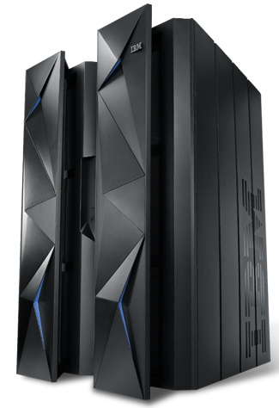


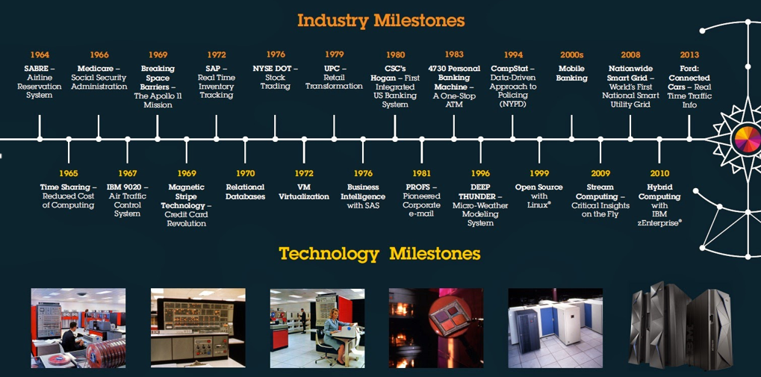

How we got here
IBM z13
Mega Memory
Simultaneous Multi-Threading
SIMD
Data Compression Acceleration
Crypto Express 5S
KVM for z Systems
IBM zAware for Linux
zBX Model 004
z/OSV2.2 Preview
z/OS SPE v2.1
+
Up to 141 | Configurable cores - CP, IFLS, zIIP, ICFs, SAP
40% | Total capacity improvement over zEC12
Up to 10 TB | >3X more available memory
Up to 320 | Separate channels of dedicated I/O
2 SODs | zKVM * and GDPS appliance for Linux on z Systems*
Sabre
The first Online Reservation System
Plus...
New Workload Container Pricing
zTPF Transformation Engine
New Multiplex Pricing
1968
1979
1982
1989
1994
2005
2014/15
Airline Control Program (ACP)
ACP
becomes TPF
TPF 3.1 (multiprocessor support and C)
z/TPF (64-bit, GNU Compiler Collection and SOA)
z/TPF (Transformation Engines, Data & Business Eventing, REST/JSON, Mongo…)
TPF 2.1 (Clustering Support)
TPF 4.1 (31-bit and virtual addressing)

Slide 5



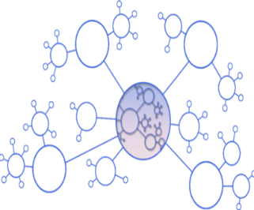




z/TPF’s strategy supports your digital transformation
Strategic Intent
Investment
Continue to deliver the z/TPF Value Proposition
Deliver enhanced performance, scale, security and RAS
Enable our clients to deliver differentiated cloud and mobile apps that take advantage of direct access to z/TPF
Extract insight from z/TPF data and deliver new value to the business
Extend the value of your z/TPF investment an enable your digital transformation
Transform the development & delivery process with DevOps and through application & database analysis tools
Expand and empower the z/TPF talent population
Plan
DevOps
Operate
Develop/ Test
Deploy
Enable progressive modernization with Java
Notes:
IMS strategy – unchanged

Slide 6
Continuing to deliver the z/TPF value proposition with z13
Performance and Scale
10 TB main memory (w/ 2x more on chip cache) on z13 (50% faster) and 2GB page support in z/TPF
Improve response time and reduce IO costs through increased caching
2x increase in I/O bandwidth to support tx and data growth on z13 w/ Forward Error Correction (FEC), 16 exabytes of addressable z/TPF database records
z13 – 8-core, 5GHz, wider pipeline, industry leading branch prediction, Single-instruction, multiple-data (SIMD) and Simultaneous Multi-Threading for specialty engines
Security
Secure key management supporting >1M encryption operations per second and Public Key Infrastructure
Central Processor Assist for Cryptographic Function (CPACF) for bulk data encryption, supporting DES, AES, SHA – delivering 2X performance
Crypto Express5S (CEX5S) Accelerator for Public key cryptography (RSA) – new for z13
Deliver enhanced performance, scale, security & RAS
RAS
Online database reorg (ODBR) to enable z/TPF database expansion without any downtime
Process (ECB) resource monitor to manage application resource consumption and improve availability
Massive in memory diagnostic buffer area to improve availability
Notes:
IMS strategy – unchanged

Slide 7
z/TPF Integration
Business Rules
z/TPF application can call enterprise Business Rules Engine in real-time
APIs and SOA
z/TPF fully supports REST/JSON and SOAP/XML integration with z/TPF applications
Business Events
z/TPF application can emit events when a business situation occurs to tell a remote event consumer to take action

Slide 8

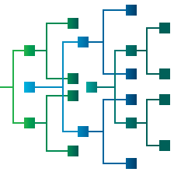


New in 2015!
Open Data Access
An application programmer can read and update z/TPF data from a distributed platform using a NoSQL interface
Data Events
A business analyst can issue standard (SQL or other) queries against a near real-time copy of the TPF data without any z/TPF application changes required
Scalability & Price Performance
An IT provider can triple the capacity of their z/TPF system with little or no application changes required
z/TPF Transformation Engines (TE) Offering
Notes:
Introduced to encourage z/TPF modernization, application extension, and integration with other IBM products
TE’s are allowed to run designated new workloads
TE’s are GP engines at a reduced price
Web Services
XML Parsing
JSON
Business Eventing
Data Eventing
DFDL Parsing
IBM Rules Engine Integration
Apache HTTP Server
z/TPF HTTP Server
LDAP
Data Compression
OpenSSL
C++ Overhead

Slide 9
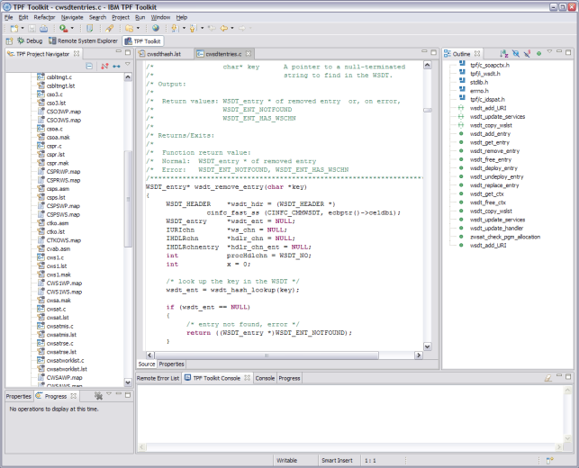


z/TPF – Open runtime and development environment
z/TPF provides a POSIX and ISO-C compliant C/C++ application runtime built with GNU Compiler Collection and libraries
What this means:
Broader market for application skills
Ease of use with open source packages providing faster time to market
Reduced integration development and maintenance costs
z/TPF relies on an open, Linux and Eclipse based development environment
What this means:
Reduced “on-ramp” costs for application developers
Modern/enterprise wide development tooling
z/TPF Run-time
Applications
z/TPF Unique APIs
POSIX/ISO Compliant built
on Linux runtime
z/TPF
z/TPF Development Environment

Slide 10








z/TPF’s Support of Open Standards and Open Source
DFDL
http
libstdc++
glibc
POSIX threads
PKI
POSIX HFS
inetd
SOAP
REST
JSON
WebSphere MQ
WSDM (CBE)
SMTP
IMAP
TCP/IP
POP3
syslog

Slide 11


Available in beta now
Sustained and aggressive investment in Java on z Systems
Significant set of new hardware features in z13 tailored and co-designed with Java
Simultaneous Multi-Threading (SMT)
2x hardware threads/core for improved throughput
Available on zIIPs and IFLs
Single Instruction Multiple Data (SIMD)
Vector processing unit
Accelerates loops and string operations
Cryptographic Function (CPACF)
Improved performance of crypto co-processors
+
New 5.0 GHz 8-Core Processor Chip
480MB L4 cache to optimize for data serving
Notes:
The importance of Java on System z
Java is a critically important language for System z. For data serving and transaction serving, which are traditional strengths of the z platform, Java has become foundational. For instance, WebSphere applications, written in Java and running on System z, provides a key advantage through co-location. The latter results in better response-times, greater throughput and reduced system complexity when driving CICS, IMS and DB2 transactions. Beyond this, as clients seek to extend and modernize their business logic, Java has become a language of choice for CICS, IMS and DB2 transactions.
Java is also critical for enabling next generation workloads in cloud, analytics, mobile and security (CAMS). Cloud and mobile applications can access data and transaction on z/OS using z/OS Connect (http://www-01.ibm.com/support/docview.wss?uid=tss1wp102439), and other WebSphere solutions – which are all inherently Java-based. IBM Operation Decision Manager (ODM) is written in Java. ODM is a platform for managing and executing business rules and business events to help make decisions faster, improve responsiveness, minimize risks and seize opportunities. The IBM MobileFirst Platform Developer Edition, formerly known as IBM Worklight Developer Edition, provides developers with the tools to quickly deploy mobile solutions using Java. System z Java also provides a full set of cryptographic functions to implement secure solutions.
A key strength of Java applications is the ability to immediately benefit from the latest hardware performance improvements using the Just In-Time JIT compiler in the latest Java SDK release.
Highlights for IBM Java 8 on IBM z13
IBM z13 and IBM Java 8 are taking Java performance to new heights! The combined benefits of IBM Java 8 and z13 features – including Single Instruction Multiple Data (SIMD) vector engine, Symmetric Multi-Threading (SMT) and improved CP Assist for Cryptographic Function (CPACF) -- are providing up-to 2X improvement in throughput-per-core for security-enabled applications and up-to 50% improvement for other generic applications.
Java 8 exploitation of System z CPACF is the default for System z9 and above on both z/OS and Linux on System z. The Java 8 SIMD exploitation requires z13 and z/OS 2.1 with PTFs. z13 zIIP SMT enablement also requires z/OS 2.1 with PTFs.

Slide 12
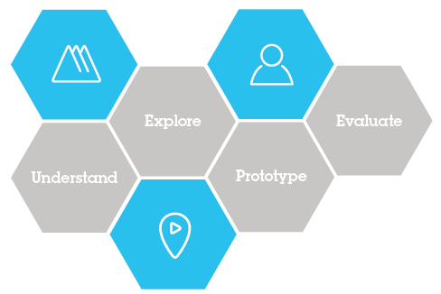




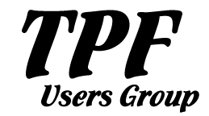
Recent Updates to how we develop z/TPF
IBM Design Thinking
Core Practices of IBM Design Thinking
Hills focus your project on big problems and outcomes for users, not just a list of feature requests.
Sponsor Users help you design experiences for real target users, rather than imagined needs.
Playbacks align your team, stakeholders, and clients around the user value you will deliver, rather than project line items.
TPF Client Architecture Board
Notes:
Hill 1
An application programmer can read and update z/TPF data from a distributed platform using an unmodified standard NoSQL client
Hill 2
A business analyst can do analytics and queries (SQL or other) against a near real-time copy of the z/TPF FIND/FILE data without any z/TPF application changes required
Hill 3
An IT provider can react to acquisitions and be able to triple the capacity of their z/TPF system with little or no application changes required
Porting IBM Java to z/TPF
In progress, likely delivery in 2016
Enables writing/porting Java (J2SE) applications on z/TPF
Addresses some key needs:
Application developer skill base
Application developer agility
Many details still to be worked out
Must co-exist with and interface with existing assembler and C/C++ applications

Slide 13

Please Note:
TPF
IBM’s statements regarding its plans, directions, and intent are subject to change or withdrawal without notice at IBM’s sole discretion.
Information regarding potential future products is intended to outline our general product direction and it should not be relied on in making a purchasing decision.
The information mentioned regarding potential future products is not a commitment, promise, or legal obligation to deliver any material, code or functionality. Information about potential future products may not be incorporated into any contract. The development, release, and timing of any future features or functionality described for our products remains at our sole discretion.
Notes:
IBM IOD 2011
9/8/2016
Prensenter name here.ppt
9/8/2016 11:26 AM
13

Slide 14


2016 z/TPF Hills
Java
Application and DB Insight
MongoDB Enhancements
A Java developer can create new or extend existing z/TPF applications using java without requiring any z/TPF knowledge
A coverage programmer can use name-value pair collection to gain new insights into system resource consumption and more quickly solve problems
Programmers using MongoDB APIs can access more data sources in a more efficient manner with increased diagnostic capabilities and lower administration costs
More standard MQ functions
Clustering, pub/sub, remote admin, and so on
Additional DevOps Integration
UrbanCode Deploy (UCD) plug-in for z/TPF
z Personal Development Tool (zPDT) support for z/TPF
Ability to unit test a z/TPF application on a laptop
Ability to encrypt data at rest without any application changes required
Foundational Hill
Notes:
Java
Ability to leverage a large programmer skill base
Improve time to market and time to value
Integration with existing applications
Co-exist with existing applications (progressive modernization)
Ability to write or port more fit for purpose code to z/TPF
ADMA
Improve time to market, time to value, and quality
Reduce burden/dependence on subject matter experts (SMEs)
Improved diagnostic capability of production system problems
Provide better information to decision makers
Integration with other DevOps tooling
MongoDB
z/TPF apps can access z/TPF data or remote data using a standard interface
Simplified/faster process to allow a remote user to access z/TPF data
Ability to debug and fix database problems caused by remote users
Ability to access non-z/TPFDF data (FIND/FILE data) remotely using a standard interface

Slide 15
A Java developer can create new or extend existing z/TPF applications using Java without requiring any z/TPF knowledge.
Sub-Hill 1 : Standard Development Tooling
A java developer can develop and unit test a java application for z/TPF using a standard Eclipse Integrated Development Environment (IDE).
Sub-Hill 2 : Seamless Integration
A java developer can call existing z/TPF applications from java without writing any transformation code or java-to-tpf linkage.
Sub-Hill 3 : z/TPF Management
A z/TPF operator can manage java workloads using familiar z/TPF commands and utilities.

Slide 16
Programmers using MongoDB APIs can access more data sources in a more efficient manner with increased diagnostic capabilities and lower administration costs.
Sub-Hill 1 : Diagnostics and Logging
The z/TPF database administrator can dynamically enable logging by user to diagnose problems caused by that user through the MongoDB interface.
Sub-Hill 2 : User Security
An administrator can define users and their database access per collection without writing code or loading files to TPF.
Sub-Hill 3 : Representing z/TPFDF Sub-File as Multiple Documents
The z/TPF database administrator can define a z/TPFDF file to allow sub-files to be represented as multiple documents.
Sub-Hill 4 : Local z/TPF MongoDB Java Client
The z/TPF Java application programmer can use a standard MongoDB client to access data on z/TPF or on a remote MongoDB server.
Sub-Hill 5 : MongoDB Support for TPF Find/File Databases
The distributed developer can access databases through the MongoDB interface that are defined as traditional TPF find/file databases.

Slide 17


A coverage programmer can use ADMA name-value pair collection to gain new insights into system resource consumption and more quickly solve problems.
Sub-Hill 1 : Improve Production System Problem Determination
A coverage programmer can analyze name-value pair collection reports to identify which message types, end users, and code packages are causing a large increase in the usage of resources.
Sub-Hill 2 : More Accurate Capacity Planning
A capacity planner can analyze name-value pair collection reports to determine how many resources (CPU, DASD, and so on) will be needed based on expected message rate growth of a specific service/application.
Sub-Hill 3 : Improve Application Design
An application architect can analyze name-value pair collection reports to identify inefficient code packages that can be refactored to improve system performance.

Slide 18

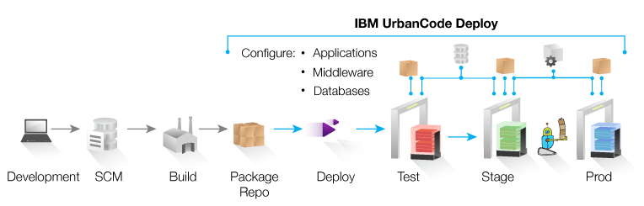
Foundational Hill – DevOps for z/TPF
Plan
DevOps
Continuous Release and Deployment
Operate
Develop/ Test
Deploy
z/TPF UCD Plug-in
Provides actions to manage program versions
Load and activate
Accept
Deactivate and delete
Built on z/TPF’s dynamic program loader, providing zero downtime and fallback capability
UrbanCode Deploy provides
Automated, consistent deployments and rollbacks of applications
Orchestration of changes across servers, tiers and components
Configuration and security differences across environments
Clear visibility: what is deployed where and who changed what
Integrated with middleware, provisioning and service virtualization

Slide 19


…Incubating....
JavaScript Engine
+
+
http://www.ibm.com/blockchain/z.html
Notes:
V8 compiles JavaScript to native machine code (IA-32, x86-64, ARM, or MIPS ISAs; has also been ported to PowerPC^{[7]} and IBM s390^{[8][9]} for use in servers)^{[3][10]} before executing it, instead of more traditional techniques such as interpreting bytecode or compiling the whole program to machine code and executing it from a filesystem. The compiled code is additionally optimized (and re-optimized) dynamically at runtime, based on heuristics of the code's execution profile. Optimization techniques used include inlining, elision of expensive runtime properties, and inline caching, among many others.
The Hyperledger Project is a collaborative effort created to advance blockchain technology by identifying and addressing important features for a cross-industry open standard for distributed ledgers that can transform the way business transactions are conducted globally.

Slide 20
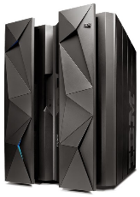

Chart your path to digital transformation with TPF Today!
Stay current on z/TPF and migrate/exploit z13 to improve performance scale
Provide easy access to TPF data using MongoDB or SQL
Begin your journey to devops to deliver agility with quality
Operate
Plan
Develop/ Test
Deploy
DevOps
2
4
1
3
API enable TPF applications to deliver value to your business fast w/ REST/JSON
Begin using Java to progressively modernize TPF applications and to create new applications

